Slide 1
AWS CloudOps Agent
Built with AWS Strands Agents and AWS Bedrock AgentCore

Slide 2
Contents
Challenges
Agentic AI
Strands Agents
AWS Bedrock AgentCore
Implementation Plan
Architecture
Cost
Demo
Discussion

Slide 3
Challenges
In Cloud-Computing

Slide 4

7 Most Common Cloud Computing Challenges
Data Security and Privacy
Cost Management
Multi-Cloud Environments
Performance Challenges
Interoperability and Flexibility
High Dependence on Network
Lack of Knowledge and Expertise

Slide 5
Agentic AI
The Evolution of Cloud Operations

Slide 6
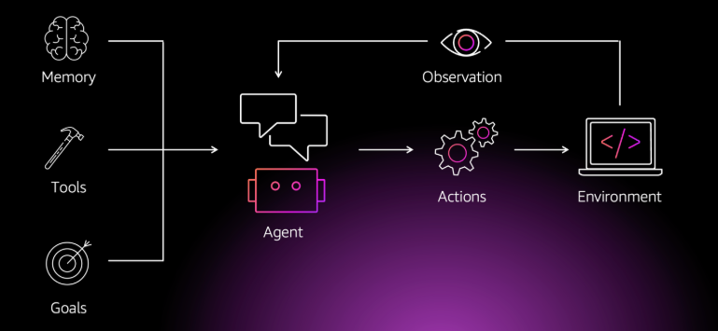

What is Agentic AI?
Agentic AI is an autonomous AI system that can act independently to achieve pre-determined goals.
"Agentic" indicates agency — the ability of these systems to act independently, but in a goal-driven manner.
__AWS__

Slide 7




Characteristics of agentic AI systems
Proactive
Adaptable
Collaborative
Specialized
Anticipate needs, identify emerging patterns, and take initiative to address potential issues before they escalate
Adapt to changing environments and specific domains by using context awareness and domain knowledge to respond intelligently
Collaborate with humans and with other agentic AI systems, can understand shared goals, interpret human intent, and coordinate actions accordingly
Builds upon multiple hyperspecialized agents, with each focused on a narrow area of expertise

Slide 8





Use cases of agentic AI
Supporting research and development
Code transformation
Customer service automation
Incident response automation

Slide 9
Cloud AI Agent Objectives
Ask and understand
Ask plain-language questions about cloud resources, incidents, and health.
Automate incidents
Diagnose, mitigate, and resolve incidents across monitoring dashboard or integrated tools.
The agent works autonomously or with approvals.
Stay proactive
Agent sends daily summaries of environment health, flags spikes in CPU/memory usage, and identifies resources that don't follow security best practices.

Slide 10
Strands Agents
An Open-Source AI Agent SDK

Slide 11
Strands Agents core concepts
The simplest definition of an agent is a combination of three things
Model
Tools
Prompt
The agent uses these three components to complete a task, often autonomously
Model
Prompt
Agent
Tools

Slide 12
Strands Agents main components
1 Model
Strands offers flexible model support.
You can additionally define your own custom model provider with Strands. (Ollama, Open AI, Anthropic, etc.)
2 Tools
You can choose from thousands of published Model Context Protocol (MCP) servers to use as tools for your agent.
3 Prompt
You provide a natural language prompt that defines the task for your agent, such as answering a question from an end user.

Slide 13
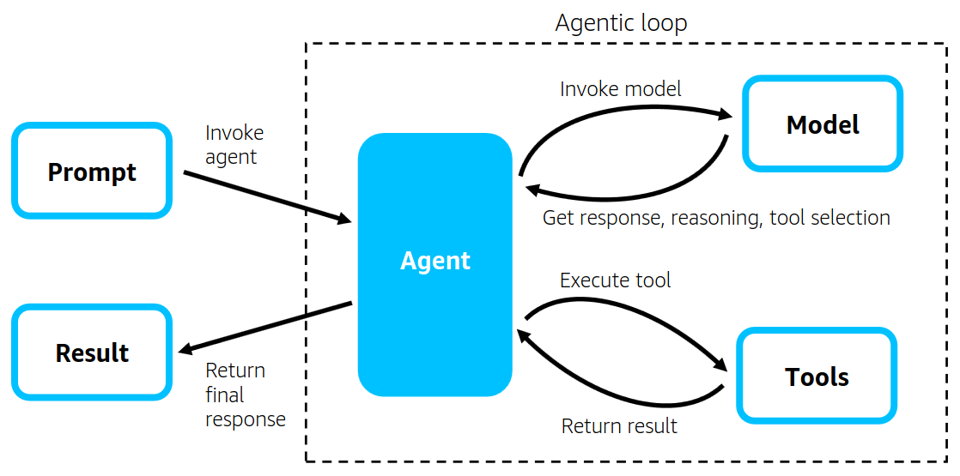
Strands Agents main components
Introducing Strands Agents, an Open Source AI Agents SDK | AWS Open Source Blog

Slide 14
AWS Bedrock AgentCore
An agentic platform for highly effective agents

Slide 15
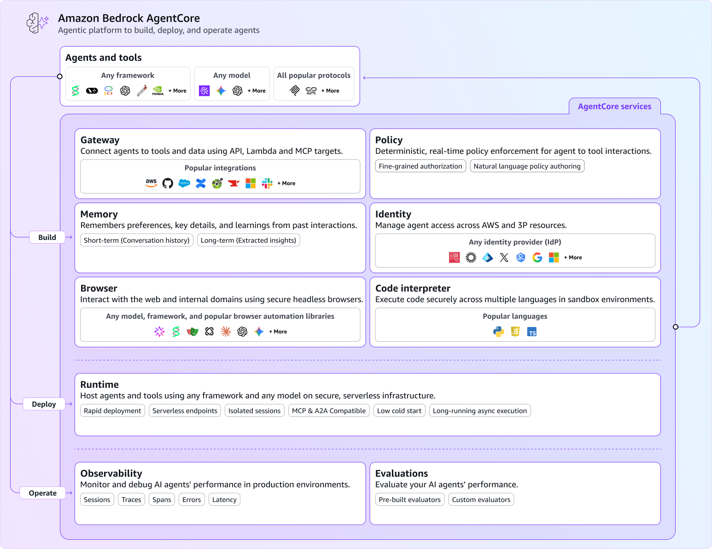
What is Amazon Bedrock AgentCore?
An agentic platform for building, deploying, and operating effective agents with enterprise-grade security and dynamic scaling
Faster time to value
Flexibility and interoperability
Security and trust at scale

Slide 16
Implementation Plan
Timeline with objectives

Slide 17
Implementation Plan
PoC
Ideas Propose Form team ASW resources setup
Detect-React Workflow
Initial Design Details Implement Scenarios Testing Agent Improvement
Demo
2025 | Oct | Nov | Dec | 2026
Deployment
Host agent on Bedrock AgentCore Front-end development Agentic components development

Slide 18
Architecture
An initial overview of the designed system

Slide 19
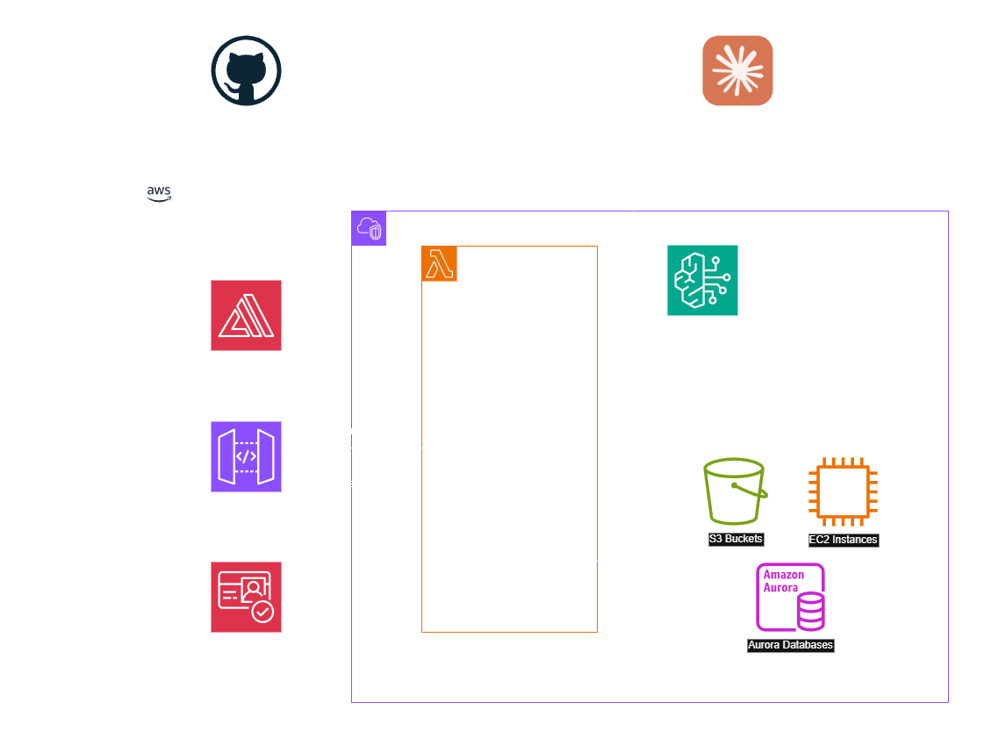
Architecture – v1

Slide 20
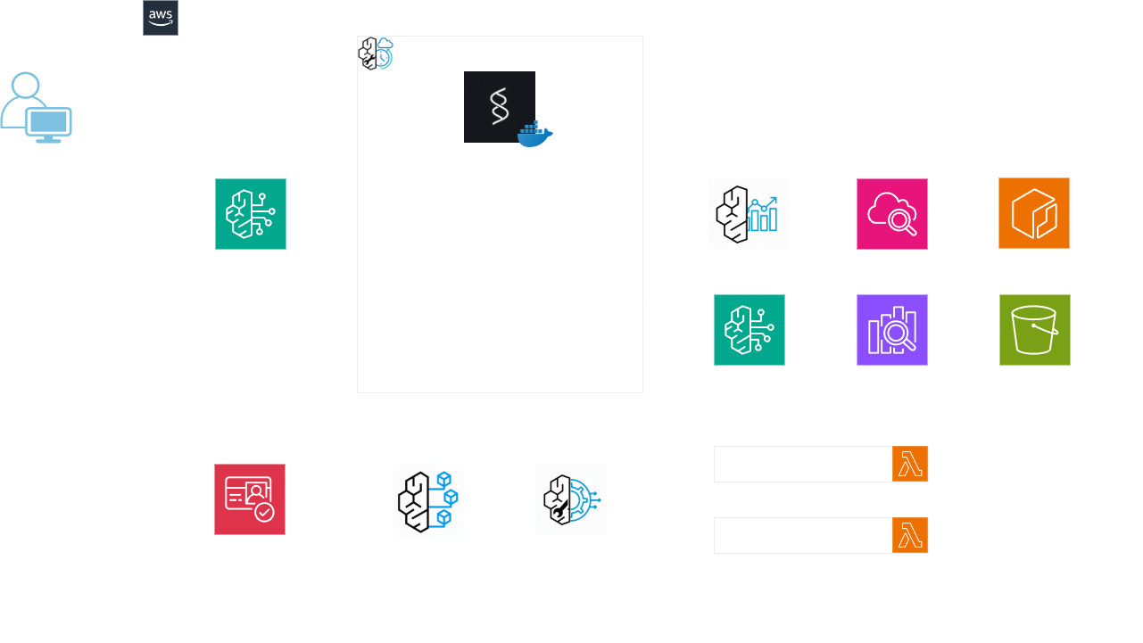
Architecture – v2

Slide 21
Architecture – RAG workflow

Slide 22
Architecture – Detect React workflow

Slide 23
Cost
Summary of AWS expenses

Slide 24
Costs Analysis
Service | Minimum | Typical | Maximum | Notes
Bedrock AgentCore Runtime | $150 | $225 | $300 | Active consumption-based
Bedrock Claude Sonnet 4.5 | $900 | $1,125 | $1,500 | Token-based pricing
ECR | $0.50 | $1.00 | $2.00 | Container storage
Bedrock Knowledge Base | $50 | $75 | $100 | Vectorization + queries
OpenSearch Service | $200 | $250 | $300 | Vector database
S3 | $2.50 | $3.50 | $5.00 | Document storage
CloudWatch | $5 | $10 | $15 | Monitoring
Lambda | $0 | $2.50 | $5 | Serverless functions
Cognito | $0 | $7.50 | $15 | User authentication
Amplify | $5 | $12.50 | $20 | Frontend hosting
Average monthly costs estimated based on AWS pricing: ~ $1,700/month

Slide 25
Model Pricing
Anthropic
On-Demand and Batch pricing
Anthropic models | Price per 1,000 input tokens | Price per 1,000 output tokens | Price per 1,000 input tokens (batch) | Price per 1,000 output tokens (batch) | Price per 1,000 input tokens (cache write) | Price per 1,000 input tokens (cache read)
Claude Opus 4.5 | $0.005 | $0.025 | $0.0025 | $0.0125 | $0.00625 | $0.0005
Claude Haiku 4.5 | $0.001 | $0.005 | $0.0005 | $0.0025 | $0.00125 | $0.0001
Claude Sonnet 4.5 | $0.003 | $0.015 | $0.0015 | $0.0075 | $0.00375 | $0.0003
Claude Sonnet 4.5 - Long Context | $0.006 | $0.0225 | $0.003 | $0.01125 | $0.0075 | $0.0006
Claude Sonnet 4 | $0.003 | $0.015 | $0.0015 | $0.0075 | $0.00375 | $0.0003
Region: Asia Pacific (Singapore)

Slide 26
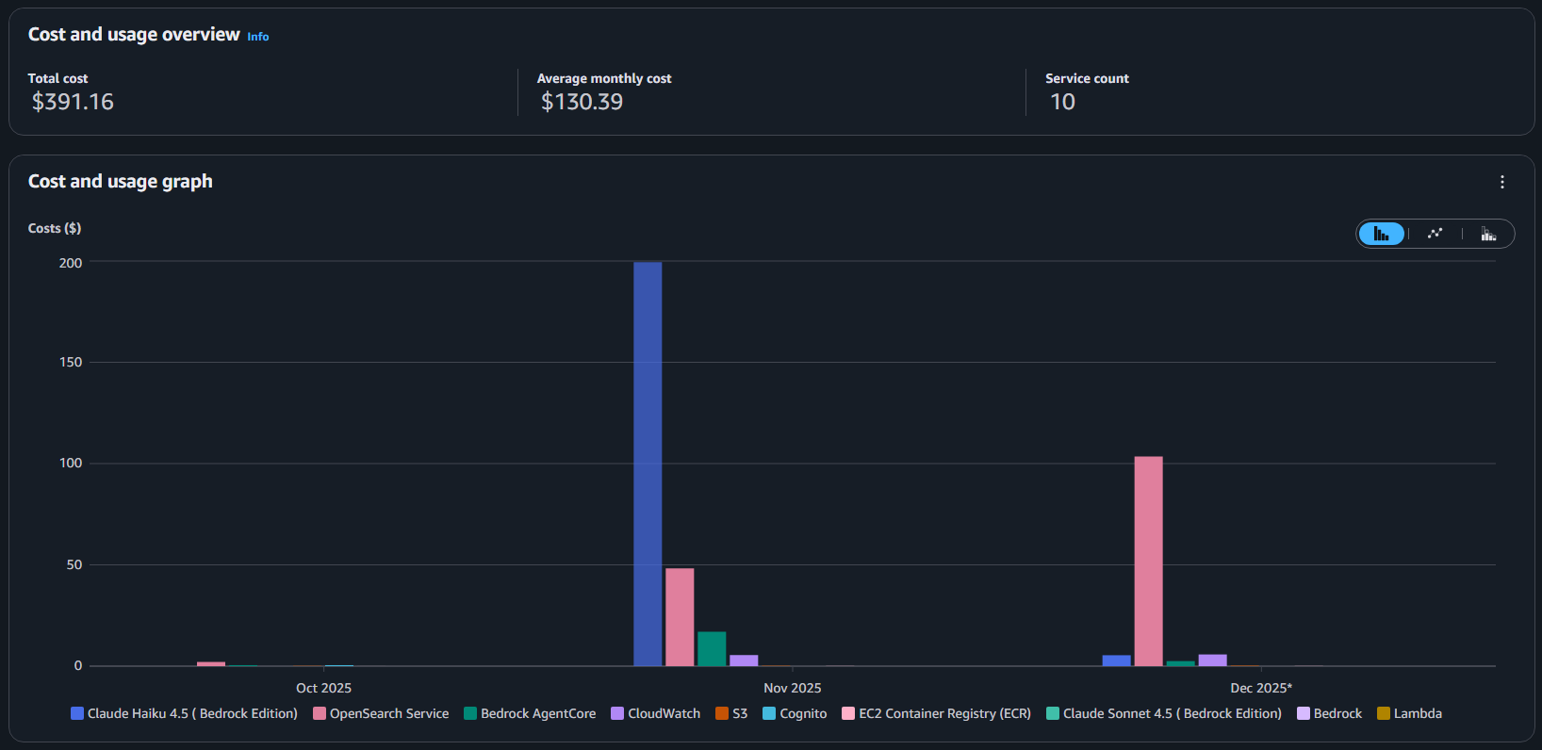
Costs and Usage report (Oct – Dec 2025)

Slide 27
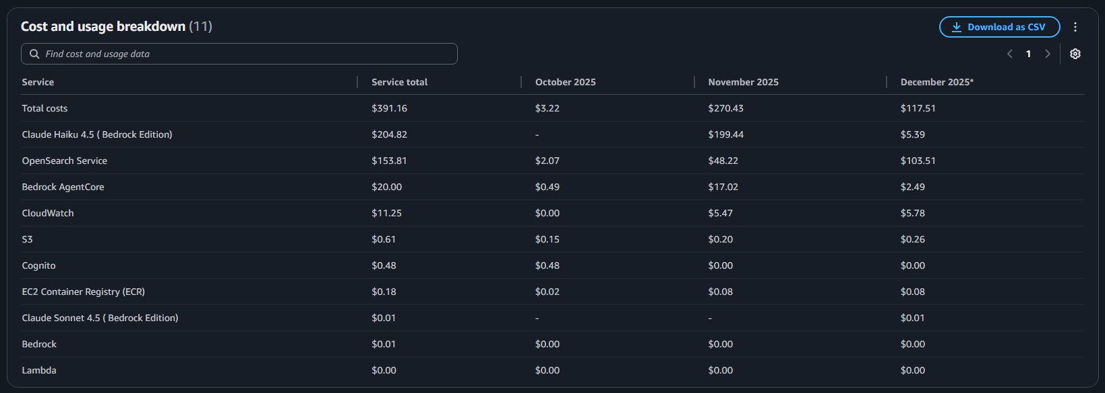
Costs and Usage report (Oct – Dec 2025)

Slide 28
Demo
Videos

Slide 29
Discussion
Feedbacks and Improvements

